Slide 1
Servlets & JSPs

Slide 2




Background of Servlet: the Applet
An optimal distributed approach led to the proposal of executing code on the browsers instead of the servers.
It required a tool to dynamically and incrementally download the application to be executed on the browser, besides, the “sand box” concept had to be satisfied in order to overcome any security risk.
It led Sun Microsystems to make a proposal using an object oriented programming language, like Java, and its java virtual machine as the “sand box” approach to be included within any browser, and those downloaded applications were named as “Applets”.
Nevertheless, a non extensive use of this technology led to think it over, and finally it was decided to move the code execution to the servers, talking about “Servlets” instead of “Applets”.

Slide 3

The Servlet
The Servlets are execute on web servers, called servlet containers, and more recently, application servers, indeed application containers, as far as its functionality goes beyond the Servlets execution,
e.g. as a message broker.
They replace the original CGIs to improve their execution and make application developing more easy.
In any case, web servers are traditionally considered as static content providers, while the application servers are dynamic content providers.

Slide 4



Servlet aim
Basically we require a tool to implement a client/server HTTP protocol dialogue:
  a tool to obtain any information contained in an HTTP
request.
  a tool to compose the HTTP reply to send back to the client.

Slide 5
Servlet's requested features
To handle objects with different scopes to implement any kind of web application
A mechanism to handle multiple requests made in the same session by the same client
Support for multiple simultaneous requests from different clients to the same Servlet. So, any concurrency inconsistency must be solved.
It would be desirable to have the option to distribute the processing of the request among different Servlets, forwarding the request among them.

Slide 6
Servlets – cycle of life
Any Servlet has a cycle of life including:
–The Servlet load
–The processing of requests
–The Servlet unload
The Servlet container handles the Servlet cycle of life. We do not need to know the details as Servlet programmers.

Slide 7
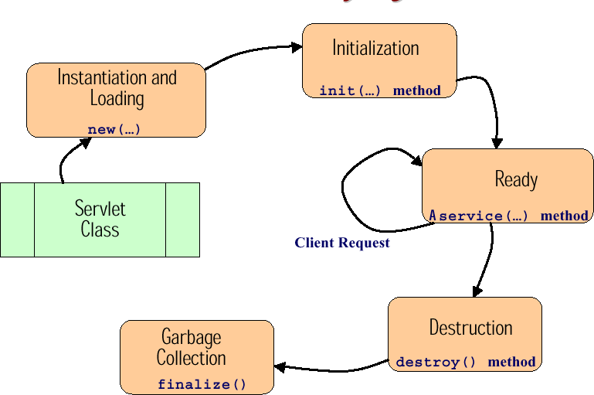

Servlets – Life cycle

Slide 8

Servlets – Life cycle
The Servlets are loaded/unloaded by the Servlet container. The container decides when to do that, on container start up, on servlet's first request, etc.
On loading any Servlet, the init() method is executed, but the init() method is called only once.
Before any Servlet is reloaded, the destroy() method is called. The same as when any Servlet is unloaded.

Slide 9



Servlets – Life cycle
The request processing results from the service() method execution, in particular, there is the option to over-write the methods: doGET(), doPOST(), etc., to distinguish which code to execute depending on the HTTP request command.
Any service() method invocation is executed in an independent thread, but the same Servlet object is used for any client request, so a multi-thread programming style is necessary.

Slide 10
Servlets – Life cycle
When calling the method destroy() it must be synchronized with the method service() due to any potential pending client request to be served.

Slide 11
Servlets – Threads (i)
There are two Servlet execution styles:
  Servlet thread-safe:
    A single instance serves concurrent requests
    Programming thread-safe Java code is necessary.
  Servlet SingleThreadModel:
    A single instance serves a single request
    Maybe successive requests are queued
    Slow procedure or memory consuming
    to avoid, or maybe not?

Slide 12
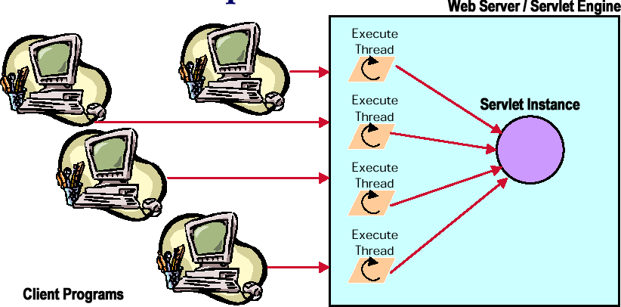
Servlets – Threads (ii)

Slide 13
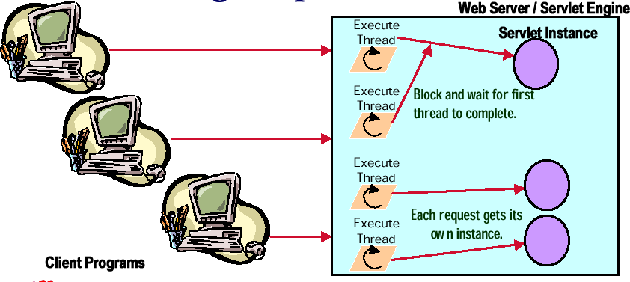

Servlets – Threads (iii)

Slide 14

Scope of objects in webApps
Within the Servlet method (page scope)
Within the request processing (request scope)
Within the session (session scope)
Within the ServletContext (application scope)

Slide 15



Scope of objects
Object
Page scope
Request
Servlet
Forward
Request scope
Object
Response
Servlet
Servlets container

Slide 16


Scope of objects
Object
Page scope
Request
Servlet
Response
Session scope
Object
Request
Servlet
Response
Servlets container

Slide 17

Scope of objects
Request
Servlet
Application scope
Request
Object
Request
Response Response
Response
Servlets container

Slide 18

Service architecture
To process an HTTP client request we must program a new class as an extension of the HttpServlet class.
When calling a method from HttpServlet class, two objects from interfaces: HttpServletRequest and HttpServletResponse are attached, as parameters of the method call.

Slide 19
Programming Servlets
Methods to over-write from HttpServlet class:
  doGet: GET or HEAD
  doPost: POST
  doPut: PUT
  doDelete: DELETE
  doOptions: OPTIONS
  doTrace: TRACE

Slide 20
Retrieving data from Request
– Accessing request parameters (query string) from HttpServletRequest class:
public String getParameter(String name); public Enumeration getParameterNames();
public String[] getParameterValues(String name);
– Accessing request headers from HttpServletRequest class:
public String getHeader(String name); public Enumeration getHeaders(String name); public Enumeration getHeaderNames();

Slide 21

Programming Servlets
To have a unique thread associated with a Servlet instance:
public class SurveyServlet extends HttpServlet
implements SingleThreadModel {
/* typical servlet code, with no threading concerns
  in the service method. No extra code for the
  SingleThreadModel interface. */
...
}

Slide 22
HttpServlet class
Methods inherited from class javax.servlet.GenericServlet:
destroy, getInitParameter, getInitParameterNames, getServletConfig, getServletContext, getServletInfo, getServletName, init, log
Methods inherited from class java.lang.Object:
clone, equals, finalize, getClass, hashCode, notify, notifyAll, toString, wait

Slide 23



Dealing with different object scopes
Page scope: no extra tool needed, just create the object within the corresponding Servlet method.
Request scope: from the HttpServletRequest instance we can set / get any object with request scope:
public Object getAttribute(String name); public Enumeration getAttributeNames();
public void setAttribute(String name, Object object);

Slide 24








Session scope
From the HttpServletRequest instance we can recover the HttpSession thru methods:
public HttpSession getSession();
public HttpSession getSession(boolean create);
With the HttpSession instance we can set / get any object of session scope:
public Object getAttribute(String name); public String[] getAttributeNames();
public void setAttribute(String name, Object value); public void removeAttribute(String name);

Slide 25





Application scope
With the ServletContext reference we can set / get any object of application scope:
public Object getAttribute(String name); public String[] getAttributeNames();
public void setAttribute(String name, Object value);
To obtain the ServletContext reference we must call the getServletContext() method from within any Servlet.

Slide 26





Over-writing the init() method
public void init() throws ServletException { Connection conn = null;
String password = getInitParameter(“usrName”);
String databaseUrl = getInitParameter("databaseUrl");
conn = DriverManager.getConnection(databaseUrl, “usrName”, password);
getServletContext().setAttribute( ”database_con", conn);
}
– The GenericServlet class provides two methods to access predefined strings of characters contained within the web application deployment descriptor file:
public String getInitParameter(String name); public Enumeration getInitParameterNames();

Slide 27



Over-writing the destroy() method
public void destroy() { Connection conn = (Connection)
getServletContext().getAttribute( ”database_con"); conn.close();
conn = null;
}
– Take into account any synchronization issue between destroy() and service() methods.

Slide 28






Forwarding the request processing
public class Example extends HttpServlet
{ public void service (HttpServletRequest request, HttpServletResponse response) throws ServletException, IOException {
Code the_code = new Code(); request.setAttribute(“code”,the_code); RequestDispatcher rd = getServletContext().getRequestDispatcher(“/next.jsp”); rd.forward(request,response);
}
}

Slide 29
Exercises
Complete the Four_Scopes_exercise managing 4 objects each one with one of the 4 defined scopes.

Slide 30
Java Server Page – definition
a JSP is an HTML file containing Java code to dynamically generate the reply to the client
the JSP elements are distinguished by tags
a JSP becomes a Servlet on run time, consequently its functionality is equivalent to a Servlet (request/reply, JSP container and dynamic loading on request)
a JSP engine is needed to work with JSPs

Slide 31

JSP – Modelling
On requesting a JSP file the application server compiles the JSP file to generate a Servlet which is later on executed.
The JSP page can obtain the necessary data from a data base directly or using other Java components referenced by the same JSP page.

Slide 32
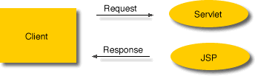
JSP – Modelling
In this case the request is sent to a Servlet to process the request and generate the reply content, later the Servlet forwards the request including the reply content to a JSP page to compose the final HTML reply.
This way the application is easier to maintain on splitting the content generation from the presentation.

Slide 33
JSP syntax
– non-XML notation:
<%@ | directive %> | <%@ | page language=“java” | %>
<%! | declarations %> | <%! | int i=0, j=5; %>
<%= | expression %> | <%= | i+7 %>
<% code fragment %> |  | <% if(i < j-4 { %>
<%-- comment --%> – XML notation: |  | <%-- this is the comment |  | --%>
directive | <jsp:directive.page | … />
declarations | <jsp:declaration> … | </jsp:declaration>
expression <jsp:expression> … </jsp:expression> code fragment <jsp:scriptlet> … </jsp:scriptlet>
comment actions
<%-- this is the comment --%>
<jsp:useBean>, etc.

Slide 34
JSP directives
include directive:
page directive:
  Language (only Java)
  extends another class (the resultant servlet)
  contentType
  import <%@ page import=“java.util.*” %>
  session true, false (supports session objects)
<%@ include file= … %>

Slide 35
Action Elements
Bean related actions:
  useBean (java object), getProperty, setProperty (on an object field):
<jsp:useBean id=“my_bean” scope=“session” class=“directory.MainBean” />
<jsp:setProperty name=“my_bean” property=“atribute_1” value=“the_value” />
include and forward actions
<jsp:include page=“test.jsp” flush=“true” />
plugin action to download on client

